Slide 2
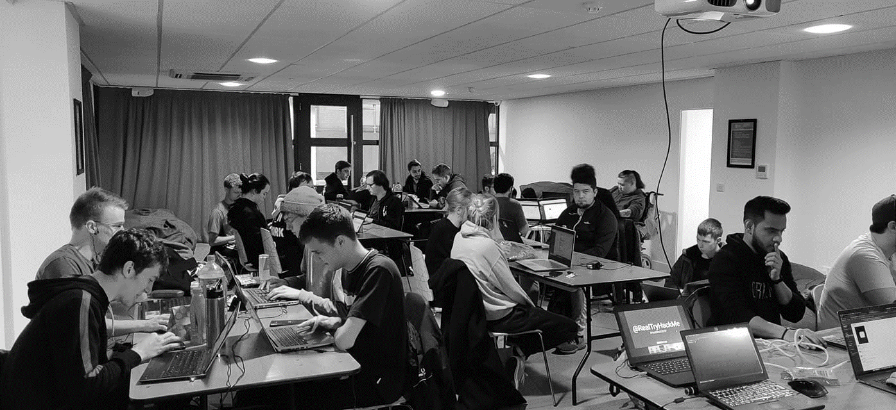



/dmuhackers
@dmuhackers
Basic Kali Tools

Slide 3



Disclaimer
Don’t do illegal shit

Slide 4
Overview
Today we will showcase some basic Kali tools
The tools that you will be shown today will be useful for any form of hacking activity
There will be a live demonstration of the ‘blue’ box from TryHackMe.
Today’s practical will require you guys to also have a go at the ‘blue’ box.

Slide 5

Kali Linux
Kali Linux is a Linux build that contains tools useful for security professionals.
Kali Linux is pre-installed on the lab machines and can be found in the Hackers folder.
It can also be found on our Github if you wish to download it for yourself. https://github.com/DMUHackers/dmuhackers-vm

Slide 6

NMap
Nmap is an open-source network mapper that is used to discover open ports and services on a network.
Nmap is a tool that will be VERY useful, so learning it early will be a great help.
Nmap is built into Kali by default.

Slide 7
Useful Nmap Switches
Firstly, if you ever struggle with switches, check out www.station.net/nmap-cheat-sheet as it features a lot of the Nmap switches. Alternatively use the command ‘man nmap’ in kali and this will tell you everything you need to know
-sU: This scans UDP ports
-F: Fast 100 port scan (Useful for things like HTTP or SSH)
-sV: Service Version. This allows for you to check if the services are vulnerable
-T0: allows for IDS evasion, -T3 is normal, -T5 is insane
-sC: scans with default NSE scripts
-oA: Outputs to a file
-v: Increases verbosity

Slide 8

Metasploit
Metasploit is a database of exploits that comes with kali linux. It is accessed via msfconsole.
The database is updated regularly and it is a great way of easily exploiting vulnerabilities.

Slide 9

Hashcat
Hashcat is a password cracking tool that comes with Kali Linux.
It allows for password hashes to be cracked and it can crack a large number of different hashing operations such as MD5 hashes, SHA-family hashes as well as some proprietary hashes used in services like MySQL.

Slide 10
Questions
Any questions?

